Slide 1

BANK CRM PROJECT
NAME : ROSHAN CHAWLA
BATCH : MAY 2024
Tools : MySQL and PowerBi

Slide 2
PROBLEM STATEMENT
High Customer Churn: The bank is facing a significant issue with customer attrition, as many customers are leaving the bank
Churn Analysis: The bank needs to analyze the factors contributing to customer churn using available datasets that include demographic data, transaction history, and exit information.
Customer Retention Strategy: The objective is to identify key reasons for customers leaving the bank and implement strategies to retain them.
Service Improvement: The bank also aims to enhance service delivery to meet customer expectations and improve long-term satisfaction.
Data Utilization: Available datasets encompass customer demographics, active customer profiles, customer exit information, and transaction details, which will be used for the analysis.
Goal: The overall goal is to reduce the customer churn rate and increase customer loyalty by addressing root causes and improving service offerings.

Slide 3
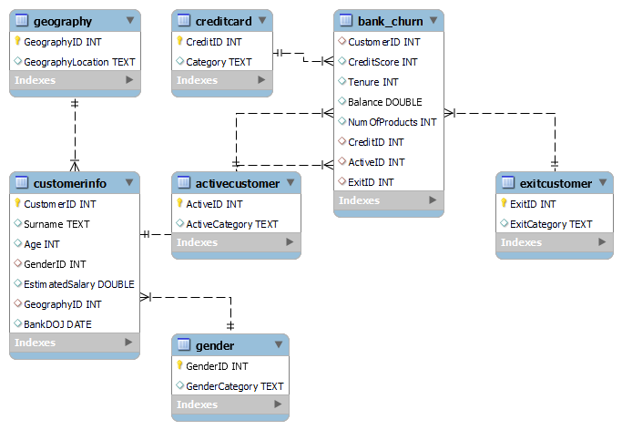
ENTITY RELATIONSHIP DIAGRAM

Slide 4
DATA OVERVIEW
Total Number of Customers : 10K
Number of Active Customers : 5151
Exited Customer: 2037
Credit Card Holders : 7055
Total Balance : 765M
Churn Rate : 20.37

Slide 5
METHODOLOGY
Data Cleaning: Formatted the 'Bank Date of Joining (DoJ)' field for consistency in Excel.
Data Enrichment: Established relationships between the tables in MySQL and enriched the dataset using JOINS to combine relevant data for analysis.
Descriptive Analysis: Extracted key metrics using SQL queries and calculated churn rates across various demographic segments.
Trend Analysis: Analyzed trends in economic indicators across different geographic regions and correlated them with the number of active accounts and customer churn rates.
Visualization: Developed dynamic charts and visual representations in Power BI to effectively communicate the insights.

Slide 6
INSIGHTS
Customer Joining Over Time
Avg Balance and Avg Estimated Salary by Exit Category
Avg Balance by Geography Location
Total Customer by Tenure
Churn Rate by Gender
Churn Rate by Credit Card Category
Churn Rate by Geography Location
Churn Rate by Age Group

Slide 7
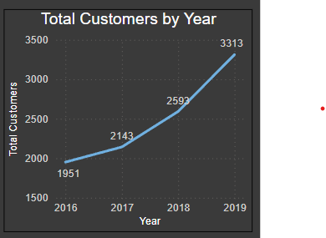
1. Customer Joining Over Time
Customer Growth: The total customer base grew steadily from 1,951 in 2016 to 3,313 in 2019, indicating successful acquisition.
Demographic Breakdown: Churn rates vary by location and gender, providing key insights for targeted retention efforts.
Retention Focus: Tailored services for active customers, based on credit and demographic data, can help reduce churn.
Churn Drivers: Factors like credit score, tenure, and product usage from the bank_churn table reveal trends contributing to customer exits.

Slide 8
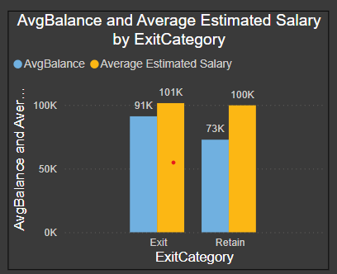
2. Number of Products and Avg balance of Exited Customers
Higher Average Balance for Retained Customers: Customers who stayed have an average balance of 100K compared to 91K for those who exited.
Lower Salary for Retained Customers: Retained customers have a lower average estimated salary (73K) compared to those who left (101K), indicating salary may not be a primary factor for retention.
Churn Analysis by Category: The bank_churn table highlights key variables like balance, credit score, and product usage to identify patterns in customer exits.
Targeted Retention Strategy: Focusing on enhancing service offerings for customers with lower balances may help reduce churn.

Slide 9
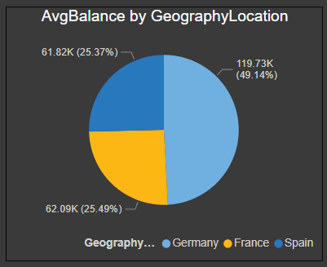
3. Avg Balance by Geography Location
Geographic Disparities in Balance: Customers in Germany hold the highest average balance (119.73K), while France and Spain have significantly lower averages, around 61-62K.
Regional Focus for Retention: The high balance in Germany suggests a need for tailored retention strategies in this region to prevent churn of high-value customers.
Customer Demographics and Churn: The ER diagram highlights relationships between customer demographics and churn factors, allowing for a deeper analysis of exits based on geography and other variables.
Credit Products Analysis: Credit card and active customer data offer opportunities to enhance product offerings and increase engagement, particularly in regions with lower average balances.

Slide 10
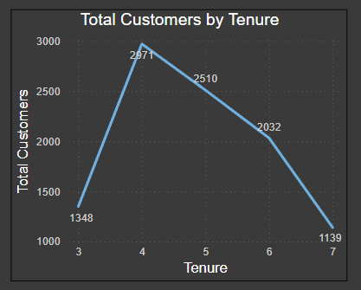
4. Total Customer by Tenure
Customer Distribution by Tenure: The highest number of customers have a tenure of 4 years, after which the total decreases sharply, indicating potential churn among long-term customers.
Tenure-Based Churn Analysis: The drop in customer numbers beyond 4 years suggests that retaining customers beyond this point may require targeted interventions.
Customer Segmentation: Using the bank_churn table, key metrics such as tenure, credit score, and balance can be analyzed to identify factors driving churn in specific tenure brackets.
Service Focus: Efforts should focus on customers in the 4-6 year tenure range, where the risk of churn seems to increase, based on the declining customer count.

Slide 11
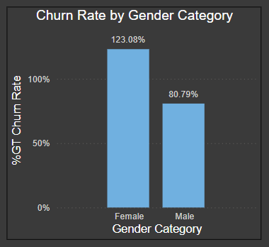
5. Churn Rate by Gender
Higher Churn Among Female Customers: Female customers have a significantly higher churn rate (123.08%) compared to male customers (80.79%).
Gender-Specific Retention Strategies: The disparity in churn rates suggests that targeted retention strategies for female customers could help reduce overall churn.
Churn Factors by Gender: Analysis of factors like balance, tenure, and credit score by gender, using the bank_churn and gender tables, can provide deeper insights into why female customers are leaving at a higher rate.
Service Personalization: Tailored services based on gender-specific behavior and preferences could be key to improving retention and reducing the churn rate.

Slide 12
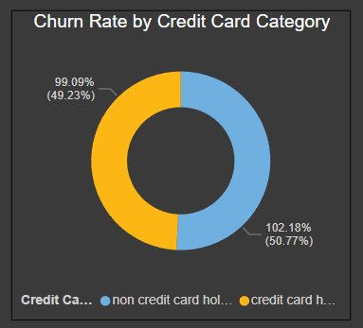
6. Churn Rate by Credit Card Category
Slightly Higher Churn for Credit Card Holders: Credit card holders have a churn rate of 102.18%, slightly higher than non-credit card holders at 99.09%.
Credit Card Impact on Churn: The marginal difference in churn rates indicates that having a credit card does not drastically affect customer retention.
Targeting Credit Card Holders: Focus on improving product offerings or benefits for credit card holders could help reduce the churn rate in this segment.
Customer Profiling by Credit Category: Analyzing churn in combination with other factors like balance and tenure from the bank_churn and creditcard tables can provide more detailed insights into customer behavior.

Slide 13
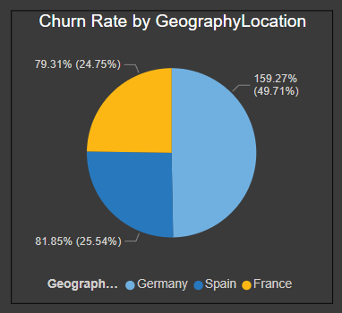
7. Churn Rate by Geography Location
High Churn in France: France has the highest churn rate at 159.27%, indicating a significant customer retention issue in this region.
Lower Churn in Germany and Spain: Germany and Spain have comparatively lower churn rates at 81.85% and 79.31%, respectively, suggesting stronger customer retention.
Geographic Focus: France may require targeted retention strategies, given its much higher churn rate compared to other regions.
Churn Analysis by Geography: The relationship between churn and geographic location from the geography and bank_churn tables offers a clear indication that location-based strategies are necessary for customer retention.

Slide 14
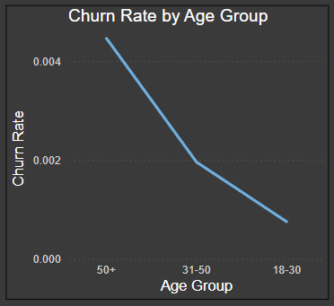
8. Churn Rate by Age Group
Churn Decreases with Age: Older customers (50+) have the highest churn rate, while younger customers (18-30) have the lowest, indicating better retention among younger demographics.
Target Older Demographics: The higher churn rate in the 50+ age group suggests a need for targeted retention strategies for older customers.
Age-Based Analysis: The customerinfo and bank_churn tables highlight the importance of analyzing churn by age group to understand and address customer behavior.
Service Adaptation: Tailoring services to meet the needs of older customers may help reduce churn in this age group.

Slide 15
CONCLUSION
Enhance early interaction and onboarding processes for new clients.
Concentrate retention strategies on customers with mid-level tenure (4-5 years).
Motivate low-balance customers with financial incentives and tools to increase their participation.
Give priority to high-balance clients by offering exclusive services and tailored perks.
Introduce credit score-targeted offers to assist customers with medium scores in improving their financial health.
Boost credit card adoption and enhance rewards programs to retain customers.
Customize marketing and retention efforts to specific geographic regions (e.g., Germany, France).
Offer exclusive benefits and personalized rewards to long-term clients.
Tailor offers and financial solutions to customer segments to enhance engagement and foster loyalty.

Slide 16
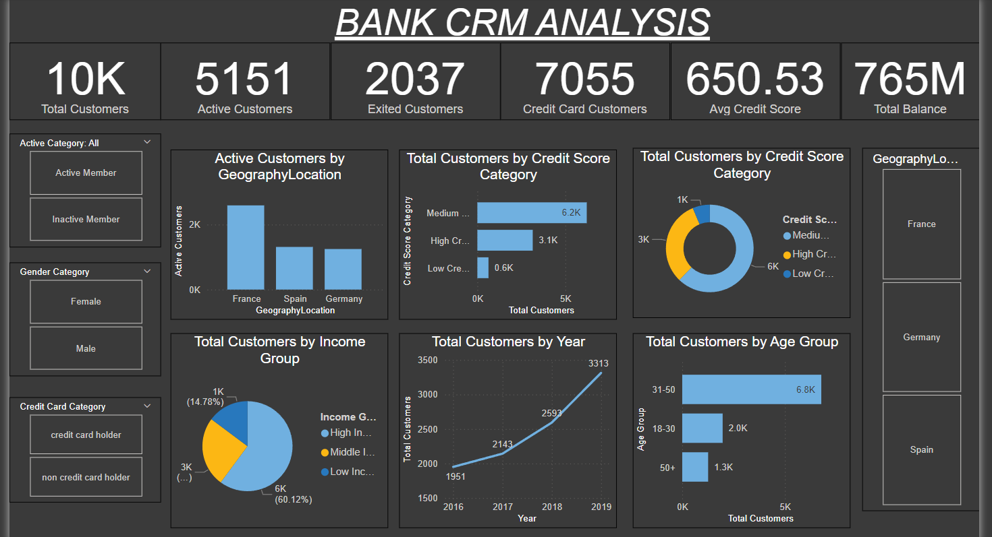
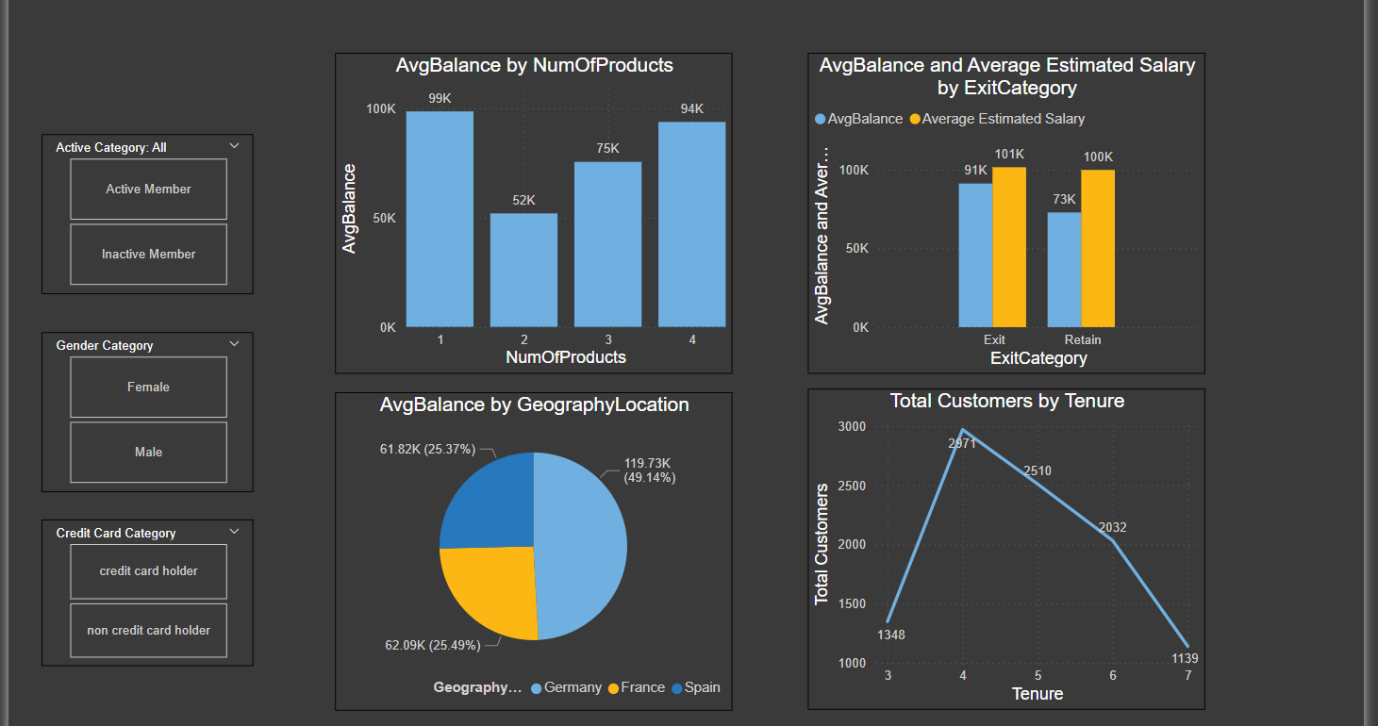
DASHBOARD

Slide 17
THANK YOU

